Slide 1
Exploring Seattle’s crimes
Aleksey Kramer

Slide 2
The need for the visualization
Relatives moving to Seattle from Taxes
Exploratory approach to find low crime areas
Showcasing data visualization with tableau
Fulfilment of the class requirements
Enhancement of the personal data visualization portfolio

Slide 3
Available data
Available data is compiled and delivered through the web
The data set contains data for the years of 2014 through 2016
Only three quarters of years 2014 and 2015 are selected – most comprehancive
The data is cleaned with incomplete rows eliminated
The data can be accessed here: https://data.seattle.gov/Public-Safety/Seattle-Crime-Stats-by-Police-Precinct-2008-Presen/3xqu-vnum

Slide 4
Design goals
Ease of navigation
Ease of visualizing data
Ability to explore maps in details – Google Maps
Ability to see type of crime, address, and etc.
Ability to easily see the number of crimes committed

Slide 5
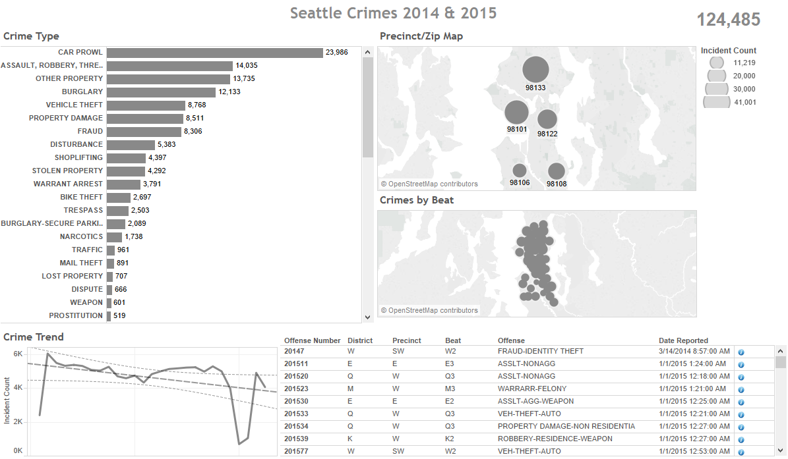
Design approach
Simple layout of elements
Map of zip codes
Tabular data with relevant details
Dynamic Crime count
Dynamic Crime trend
Color schema/lables

Slide 6
Navigation
Click on elements on the maps
Hover over the information icon in tabular data
Click on the row in tabular to display url actions
Click on the links displayed in steep 3 to view google maps location

Slide 7
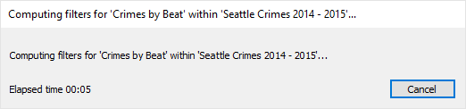
Limitations
Limited data set
Old laptop affects performance
Tableau skills

Slide 8
Questions
Q & A

Slide 9
The end
Thank you

